Slide 1
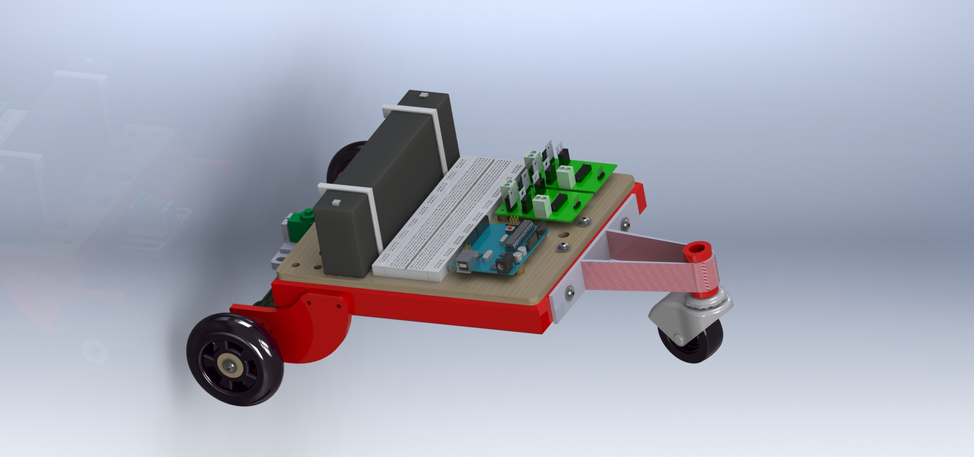
MIT 101 Project Overview and Progress Report
Presented by Luis Gomez

Slide 2
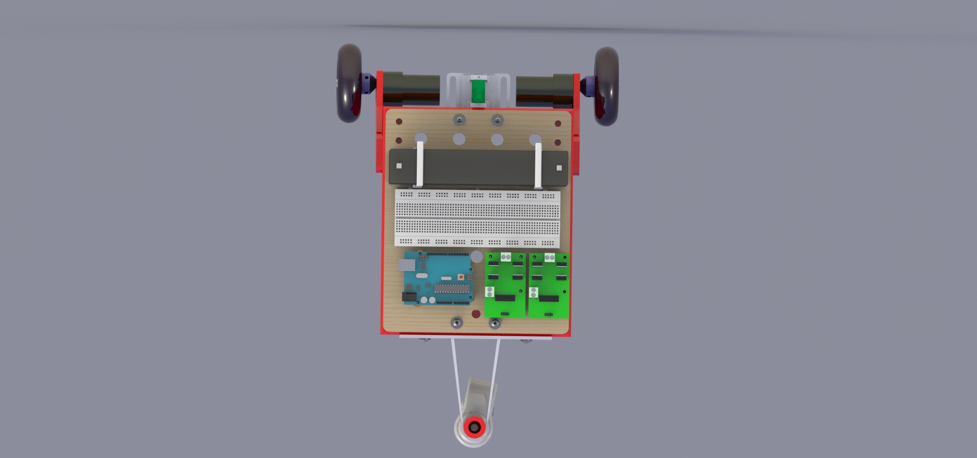
Top View

Slide 3
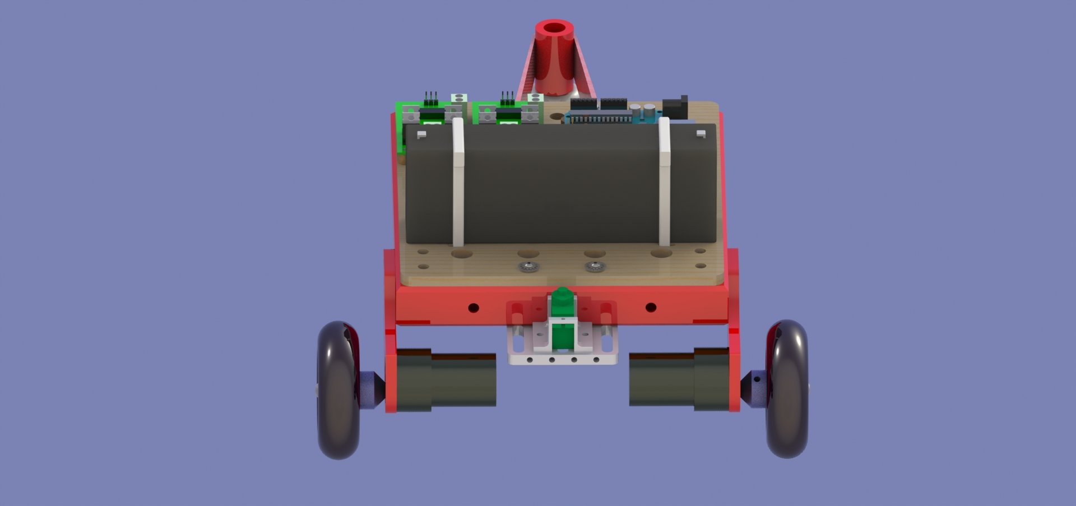
Front View

Slide 4
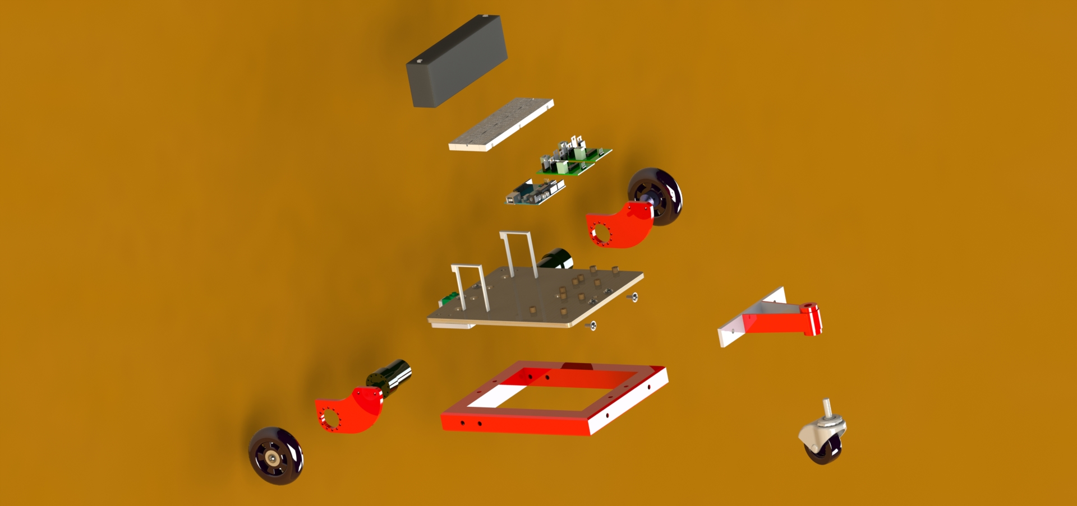
CAD Assembly

Slide 5
CAD
Preliminary work includes creating sketches and defining dimensions of vehicle
Secondary stage entails 3-d extrusion of object and detailing features such as: chamfer cuts, fillet, threading, and adding welds
Final stage is the assembly & rendering process: allowing for a detailed viewing of the project before assembly

Slide 6
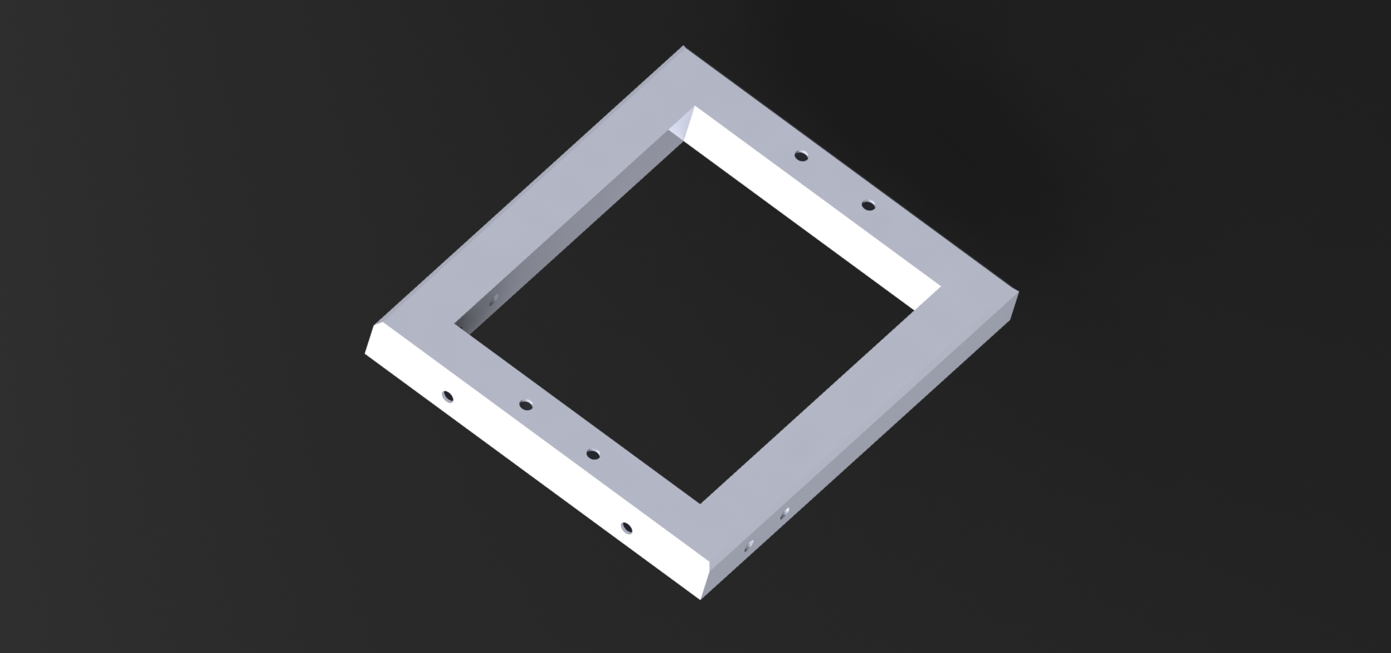
Gas Welding the Frame

Slide 7
Oxygen/Acetylene Gas Welding
Steel Frame was successfully cut, aligned, welded, and de-burred using welding shop equipment
Prior to frame manufacture, welding experience was gained by working on several varieties of steel plates and welding techniques (i.e. tig welding, arc welding)
Welding an aluminum frame for final project is possible using the aforementioned techniques, albeit at a drastically lower temperature

Slide 8
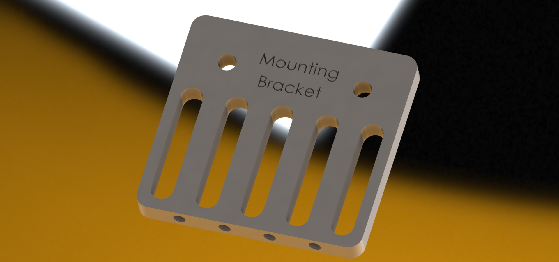
Machining the Mounting Bracket

Slide 9
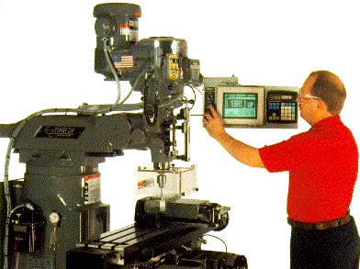
Milling the Mounting Bracket
Preliminary work includes aligning the edges of the mill work surfaces and finding the “zero” of the work space
Using the established “zero” a Cartesian coordinate grid can be devised and used execute precise maneuvers within tolerance levels
Mill techniques and procedures include: drilling, slotting, tapping, and threading

Slide 10
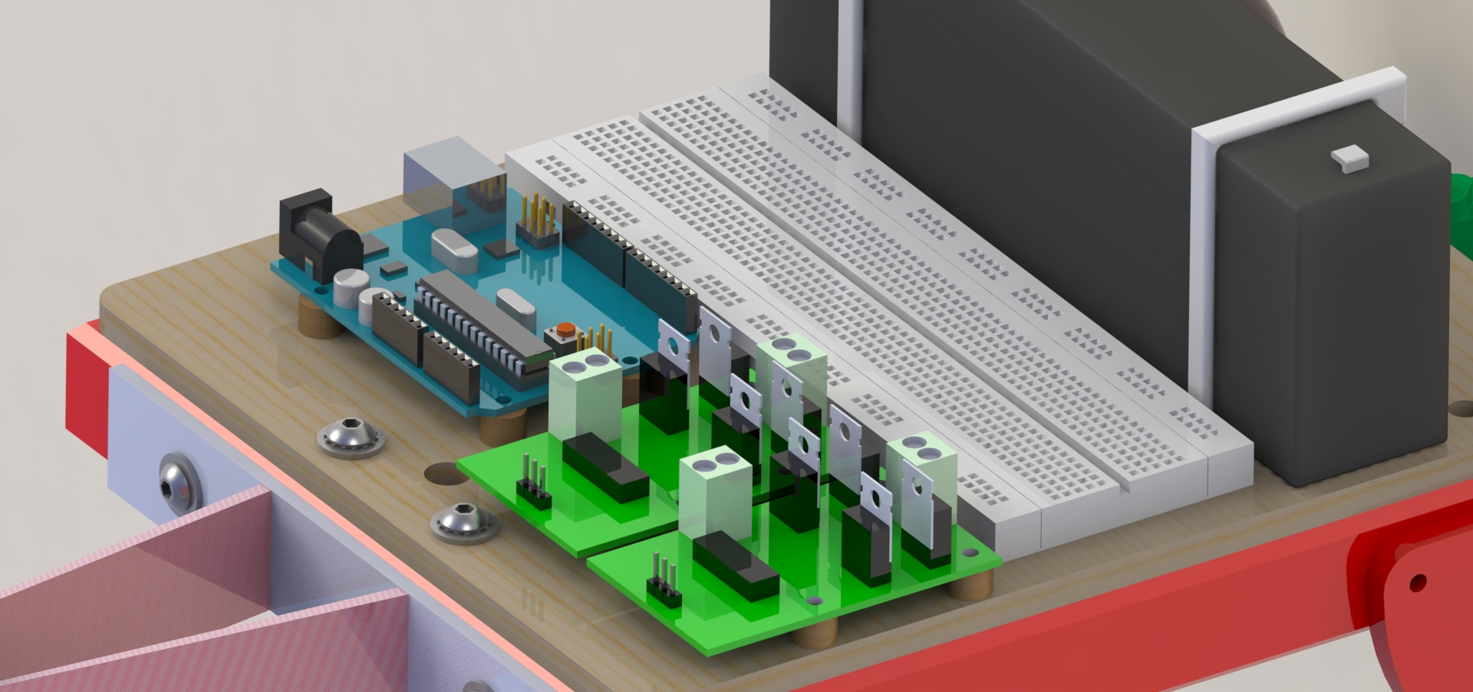
Arduino Micro Controller, H-Bridges, and Bread Board Circuitry

Slide 11
Electronics
Dual H-bridge design could be reproduced in final project for control of two motors
Lithium battery could provide advantages in terms of size but cost is an obstruction
Bread Board circuitry is ideal for experimentation
Arduino Uno will remain in use as it is a familiar microcontroller platform

Slide 12
Cost Analysis
Lancerbot Alpha Parts List & Itemized Costs
Bill of Materials (BOM)
Manufacturing Costs

Slide 13
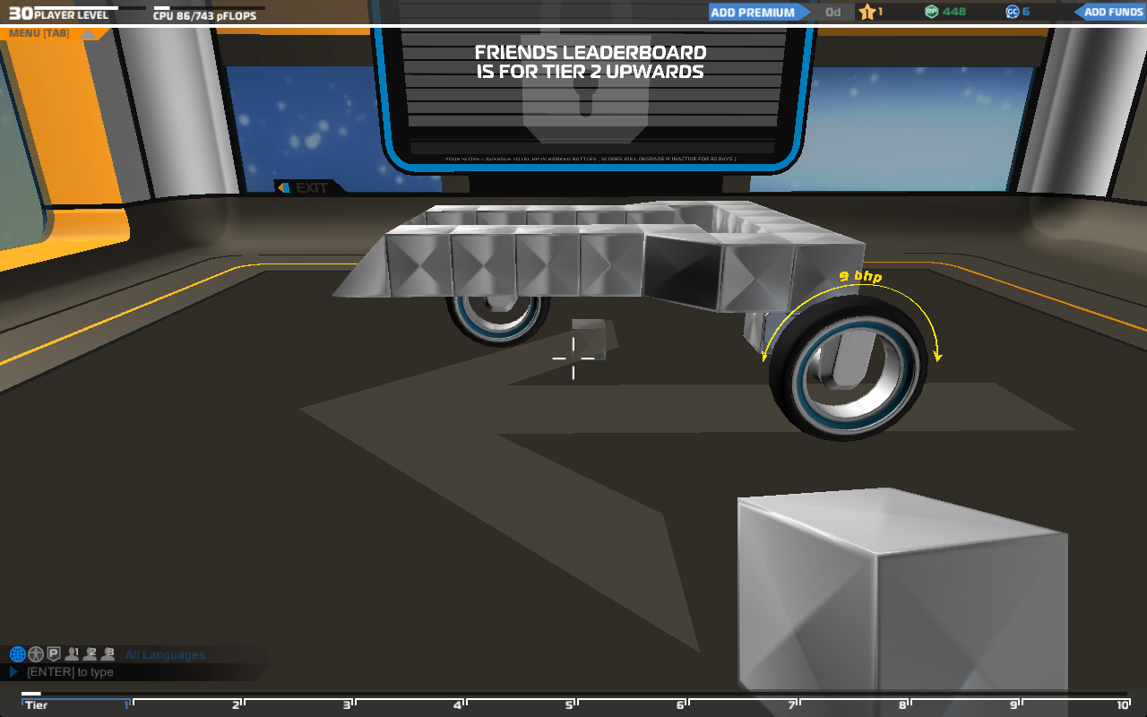
Low Profile Aluminum Chassis with Sloped Surfaces

Slide 14
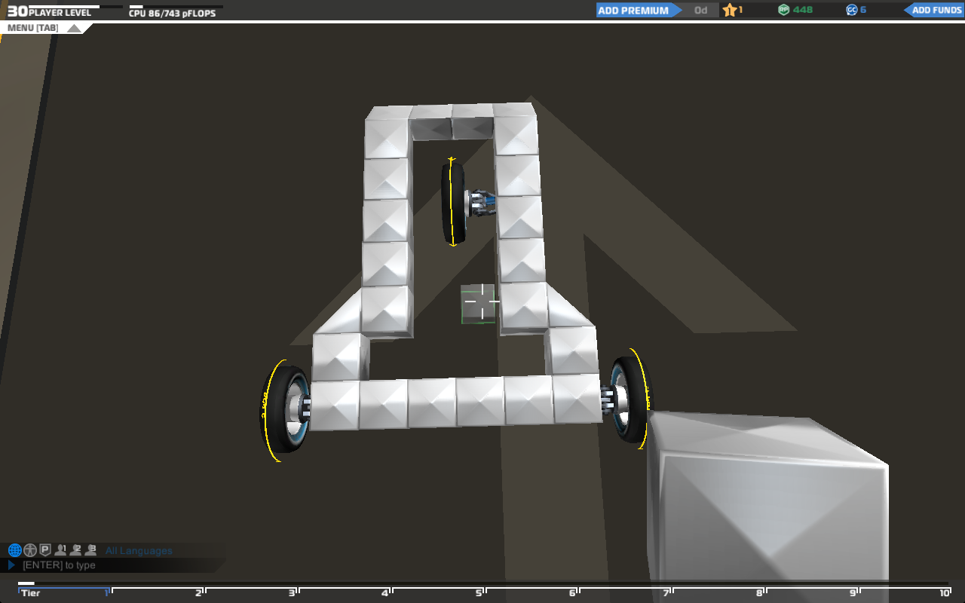
Component placement within frame perimeter

Slide 15
Lessons Learned & Best Practices
Collaborate with peers and leverage individual strengths
Always center CAD assemblies on planes when starting out
Start early, give yourself the time to troubleshoot details along the way
When in doubt, do additional research

